Slide 1
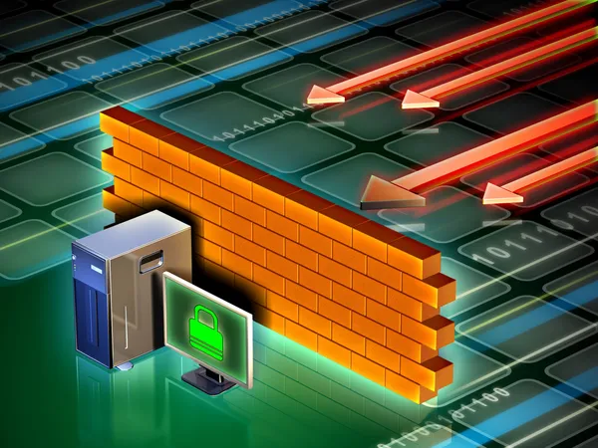
Features and Capabilities of different Firewalls
Nawaz Farooqui
Senselearner

Slide 2


What is Firewalls
Firewalls are essential network security devices that monitor and control incoming and outgoing network traffic based on predetermined security rules.
They provide a barrier between trusted internal networks and untrusted external networks, protecting against unauthorized access and potential threats

Slide 3
Packet-Filtering Firewalls
Packet-filtering firewalls operate at the network layer (Layer 3) of the OSI model and make filtering decisions based on packet header information, such as source and destination IP addresses, ports, and protocol types.
Features and Capabilities:
Filters packets based on simple rules.
Examines packet headers quickly, allowing for efficient processing.
Can handle high traffic volumes without significant impact on network performance.
Supports basic network address translation (NAT).

Slide 4
Packet-Filtering Firewalls
Strengths:
Efficient and performant, as they operate at a low level in the network stack.
Simple configuration and implementation.
Can be implemented in both hardware and software form.
Weaknesses:
Lack of visibility into the actual contents of packets.
Vulnerable to IP spoofing and address-based attacks.
Limited ability to inspect and control application-layer protocols.

Slide 5
Stateful Firewalls
Stateful firewalls, also known as dynamic packet-filtering firewalls, maintain a record of established connections and make filtering decisions based on the state of network connections.
Features and Capabilities:
Tracks the state of network connections to allow returning packets based on the established state.
Can perform basic packet filtering based on header information.
Supports basic network address translation (NAT).
Provides limited support for application-level protocols.

Slide 6
Stateful Firewalls
Strengths:
Improved security compared to packet-filtering firewalls by considering the state of connections.
Can identify and block unauthorized traffic that does not match any established connections.
Provides improved protection against certain types of network-based attacks.
Weaknesses:
May introduce additional latency due to connection state tracking.
Vulnerable to application-layer attacks that can bypass traditional stateful inspection.
Limited visibility into application-specific protocols.

Slide 7
Application-Layer Firewalls
Application-layer firewalls operate at the application layer (Layer 7) of the OSI model and provide deep packet inspection, allowing for granular control and inspection of network traffic.
Features and Capabilities:
Analyzes the contents of packets, including application-specific data.
Provides granular control over network traffic based on application-level protocols and data.
Offers enhanced visibility into network traffic and content.
Can block sophisticated application-layer attacks.

Slide 8
Application-Layer Firewalls
Strengths:
Granular control over network traffic based on application-level protocols and data.
Ability to detect and block sophisticated application-layer attacks.
Enhanced visibility into network traffic and content.
Weaknesses:
Higher resource requirements due to deep packet inspection and protocol parsing.
Increased complexity and configuration overhead.
Can introduce additional latency and impact network performance.

Slide 9
Next-Generation Firewalls (NGFWs)
Next-generation firewalls integrate features from multiple firewall types and incorporate additional security functions to provide comprehensive network security.
Features and Capabilities:
Packet filtering, stateful inspection, and application-level inspection capabilities.
Intrusion prevention systems (IPS) for detecting and blocking network attacks.
Virtual private network (VPN) support for secure remote access.
Web filtering to control and monitor web traffic.
Advanced threat intelligence and behavior-based analysis.
User and application awareness for policy enforcement.

Slide 10
Next-Generation Firewalls (NGFWs)
Strengths:
Comprehensive security features in a single device.
Enhanced protection against a wide range of threats.
Greater visibility and control over network traffic.
Integration of additional security functions simplifies network architecture.
Weaknesses:
Higher cost compared to traditional firewalls.
Increased resource requirements due to additional security features.
Potential performance impact due to deep inspection and analysis.

Slide 11
Thank You

